Slide 1

Weather Pattern Prediction Using Big Data Analytics
This presentation explores the emerging role of big data analytics in predicting weather patterns.

Slide 2
Introduction to Weather Patterns
Atmospheric Dynamics
Predictability and Chaos
Weather patterns are complex, dynamic interactions of atmospheric variables like temperature, pressure, and wind.
Weather is inherently chaotic, making accurate long-term forecasting challenging. However, short-term predictions are possible with advanced tools.

Slide 3




Limitations of Traditional Forecasting Methods
Limited Data
Time Constraints
Traditional methods rely on limited data points and historical observations, making them less accurate for unpredictable events.
Forecasting requires significant time for analysis and processing, impacting response times during urgent weather events.
Accuracy Limitations
While effective for short-term forecasts, traditional methods struggle to predict complex weather events with high accuracy.

Slide 4

The Rise of Big Data in Weather Prediction
Vast Data Collection
Real-Time Monitoring
Big data enables gathering massive amounts of weather-related data from diverse sources, including satellites, weather stations, and sensors.
Continuous data streams provide real-time updates on weather conditions, allowing for more accurate and immediate predictions.
Advanced Analytics
Sophisticated algorithms and machine learning techniques can analyze massive datasets to uncover complex weather patterns and trends.

Slide 5
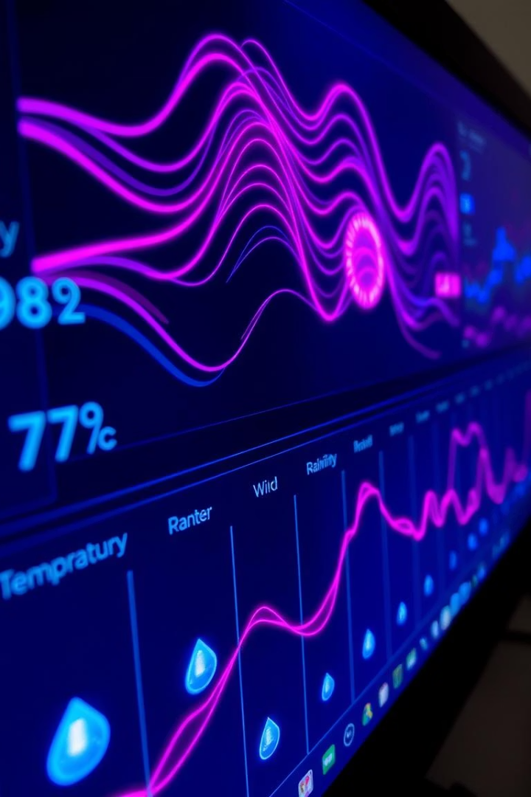



Data Sources and Preprocessing
Satellite Imagery
Weather Stations
Sensors
Ground-based stations measure temperature, pressure, humidity, and wind speed, providing localized data for accurate predictions.
Smart sensors in various locations can monitor specific weather parameters like rainfall, wind gusts, and air quality.
Satellites capture images of cloud formations, temperature, and precipitation, providing a comprehensive overview of weather patterns.

Slide 6






Predictive Modeling Techniques
Machine Learning
Using algorithms to identify patterns and make predictions based on vast datasets.
Time Series Analysis
Deep Learning
Predicting future weather patterns based on historical trends and seasonal variations.
Employing neural networks to learn complex relationships in weather data and make accurate predictions.

Slide 7
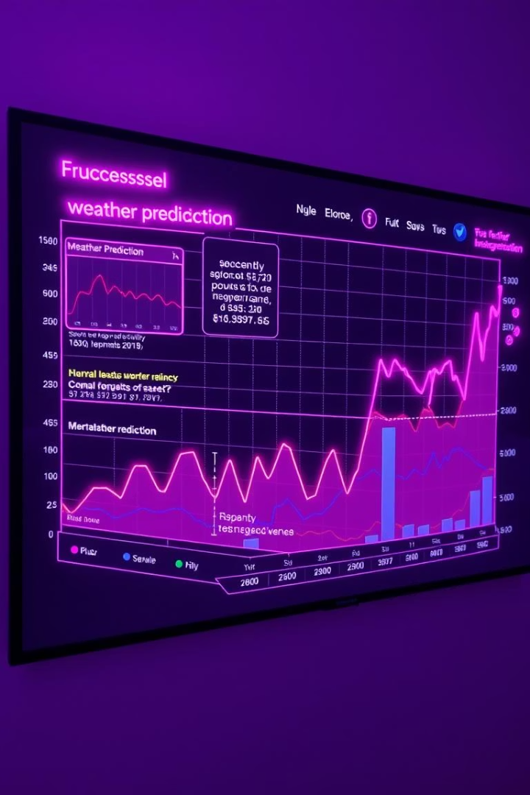



Validating and Refining the Prediction Models
Backtesting
Evaluating model accuracy by comparing predictions to historical weather data.
Parameter Tuning
Optimizing model parameters to enhance prediction accuracy and minimize errors.
Continuous Improvement
Regularly updating models with new data and feedback to maintain accuracy and adapt to changing conditions.

Slide 8




Practical Applications and Future Potential
Urban Planning
Aviation
Agriculture
Predicting heatwaves and storms to improve infrastructure and urban resilience.
Optimizing flight paths and avoiding turbulence to enhance safety and efficiency.
Predicting rainfall and temperature to optimize irrigation and crop yields.

